Slide 1

Programming with Python
Chapter 7

Slide 2
Simple Graphics
Graphics: Discipline that underlies the representation and display of geometric shapes in two- and three-dimensional space
A Turtle graphics toolkit provides a simple and enjoyable way to draw pictures in a window
turtle is a non-standard, open-source Python module

Slide 3
Overview of Turtle Graphics
Turtle graphics originally developed as part of the children’s programming language Logo
Created by Seymour Papert and his colleagues at MIT in the late 1960s
Analogy: Turtle crawling on a piece of paper, with a pen tied to its tail
Sheet of paper is a window on a display screen
Position specified with (x, y) coordinates
Cartesian coordinate system, with origin (0, 0) at the center of a window

Slide 4
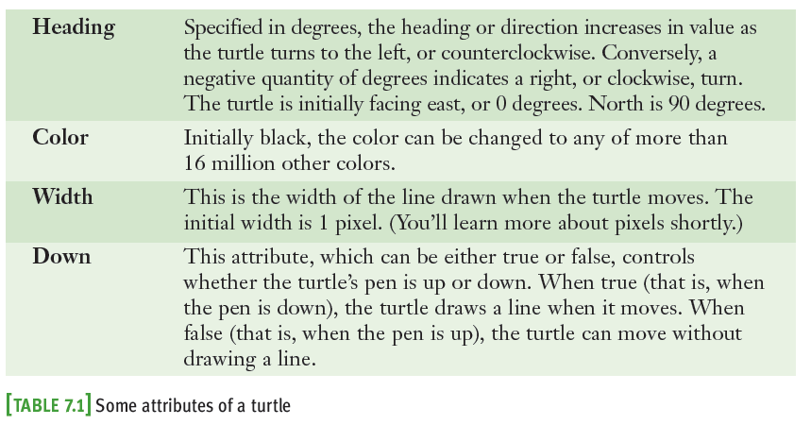
Overview of Turtle Graphics
Together, these attributes make up a turtle’s state

Slide 5
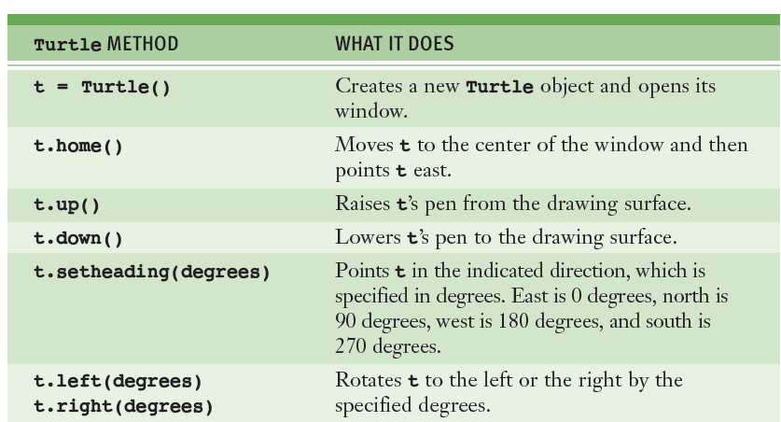

Turtle Operations

Slide 6
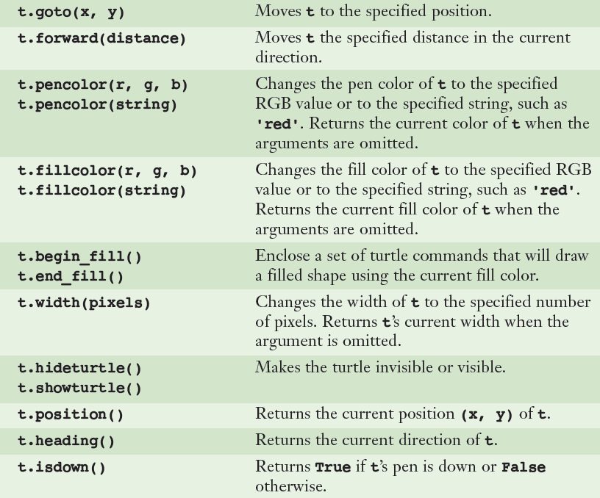
Turtle Operations

Slide 7
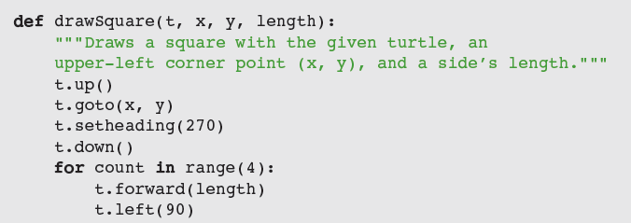
Turtle Operations
Interface: set of methods of a given class
Used to interact with an object
Use docstring mechanism to view an interface
help(<class name>)
help(<class name>.<method name>)

Slide 8


Object Instantiation and the turtle Module
Before you apply any methods to an object, you must create the object (i.e., an instance of)
Instantiation: Process of creating an object
Use a constructor to instantiate an object:
To instantiate the Turtle class:

Slide 9
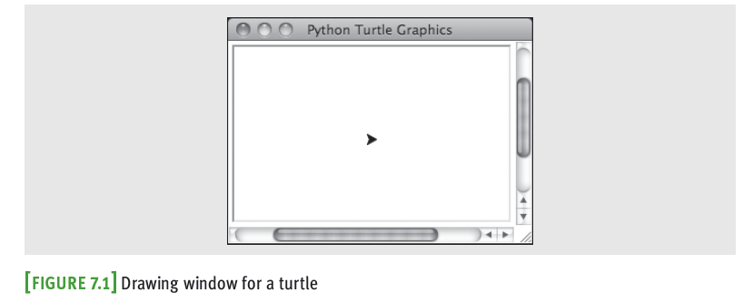
Object Instantiation and the turtle Module
To close a turtle’s window, click its close box
Attempting to manipulate a turtle whose window has been closed raises an error

Slide 10
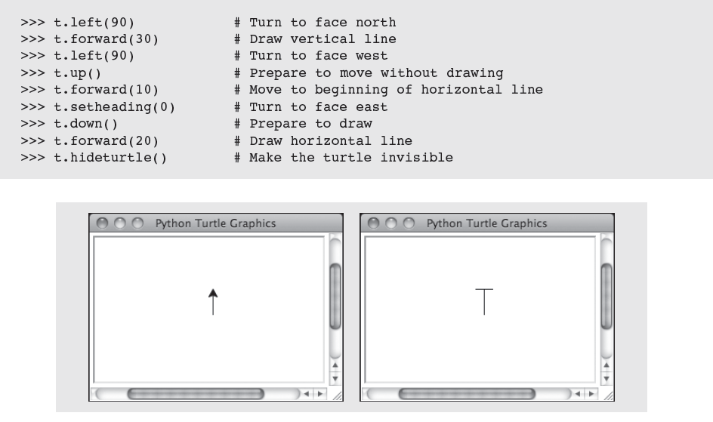
Object Instantiation and the turtle Module

Slide 11
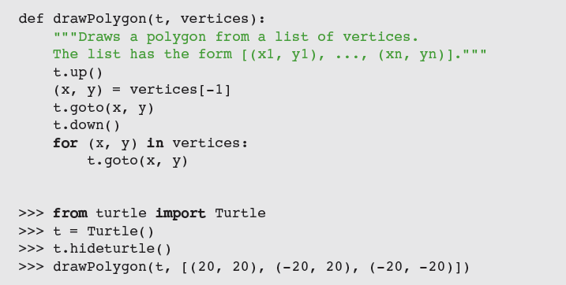
Drawing Two-Dimensional Shapes
Many graphics applications use vector graphics, or the drawing of simple two-dimensional shapes, such as rectangles, triangles, and circles

Slide 12
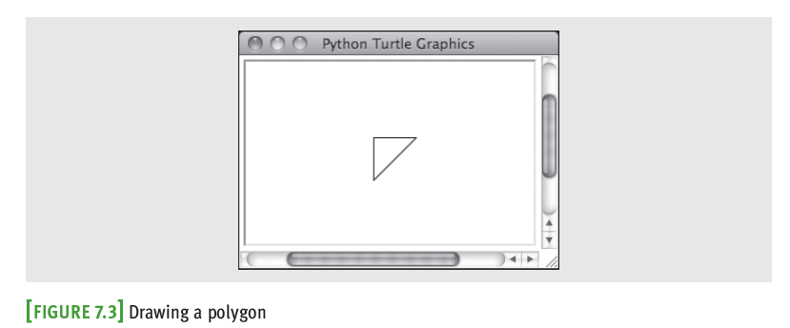
Drawing Two-Dimensional Shapes

Slide 13
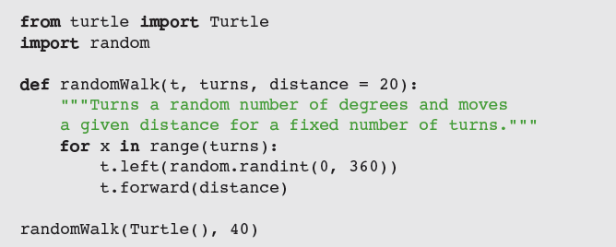
Taking a Random Walk
Like any animal, a turtle can wander around randomly:

Slide 14
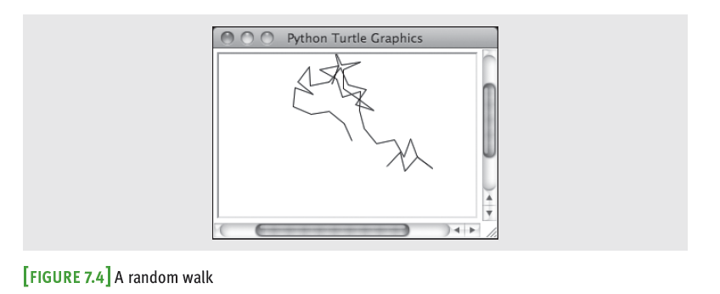
Taking a Random Walk

Slide 15
Colors and the RGB System
Display area on a computer screen is made up of colored dots called picture elements or pixels
Each pixel represents a color – the default is black
RGB is a common system for representing colors
RGB stands for red, green, and blue
Each color component can range from 0 – 255
255 → maximum saturation of a color component
0 → total absence of that color component
A true color system

Slide 16
Colors and the RGB System
Each color component requires 8 bits; total number of bits needed to represent a color value is 24
Total number of RGB colors is 2²⁴ (16,777,216)

Slide 17
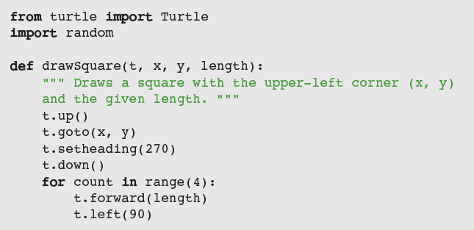
Example: Drawing with Random Colors
The Turtle class includes a pencolor method for changing the turtle’s drawing color
Expects integers for the three RGB components

Slide 18
Examining an Object's Attributes
Mutator methods change the internal state of a Turtle method
Example: pencolor method
Accessor methods return the values of a Turtle object’s attributes without altering its state
Example: position method

Slide 19

Manipulating a Turtle’s Screen
The Screen object’s attributes include its width and height in pixels and its background color
Use t.screen to access a turtle’s Screen object, then call a Screen method on this object

Slide 20
Case Study: Recursive Patterns in Fractals
Fractals are highly repetitive or recursive patterns
A fractal object appears geometric, yet it cannot be described with ordinary Euclidean geometry
Strangely, a fractal curve is not one-dimensional, and a fractal surface is not two-dimensional
Every fractal shape has its own fractal dimension
One example of a fractal curve is the c-curve

Slide 21
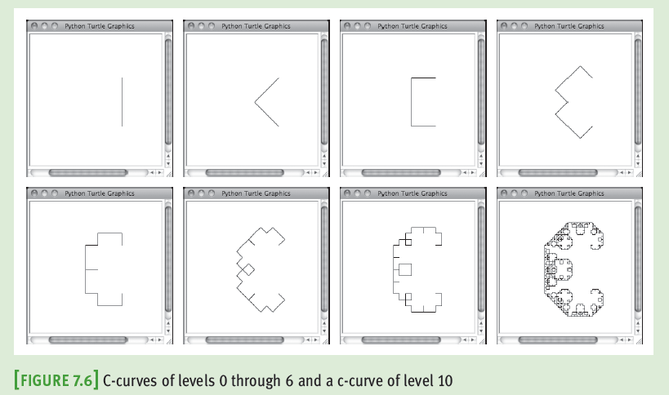
Case Study: Recursive Patterns in Fractals

Slide 22
Case Study: Recursive Patterns in Fractals
Request:
Write a program that allows the user to draw a particular c-curve in varying degrees
Analysis:
Program should prompt the user for the level of the c-curve
Next, program should display a Turtle graphics window in which it draws the c-curve

Slide 23
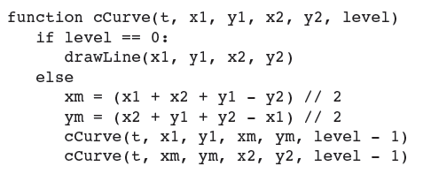
Case Study - Design

Slide 24
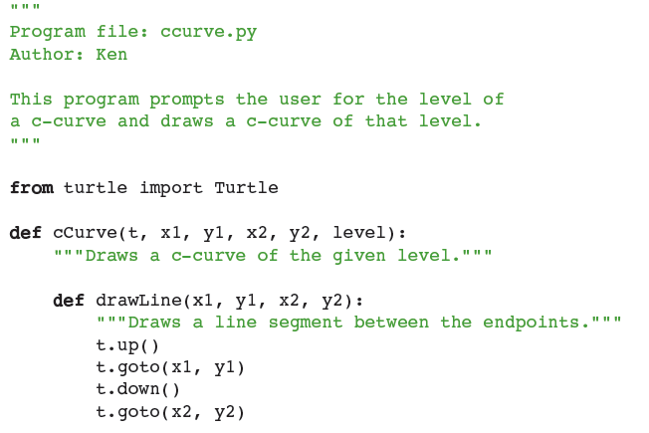
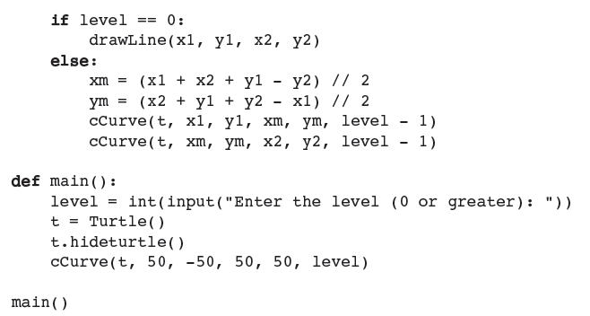
Case Study - Implementation

Slide 25
Image Processing
Digital image processing includes the principles and techniques for the following:
The capture of images with devices such as flatbed scanners and digital cameras
The representation and storage of images in efficient file formats
Constructing the algorithms in image-manipulation programs such as Adobe Photoshop

Slide 26
Analog and Digital Information
Computers must use digital information which consists of discrete values
Example: Individual integers, characters of text, or bits
The information contained in images, sound, and much of the rest of the physical world is analog
Analog information contains a continuous range of values
Ticks representing seconds on an analog clock’s face represent an attempt to sample moments of time as discrete values (time itself is analog)

Slide 27
Sampling and Digitizing Images
A visual scene projects an infinite set of color and intensity values onto a two-dimensional sensing medium
If you sample enough of these values, digital information can represent an image more or less indistinguishable (to human eye) from original scene
Sampling devices measure discrete color values at distinct points on a two-dimensional grid
These values are pixels
As more pixels are sampled, the more realistic the resulting image will appear

Slide 28
Image File Formats
Once an image has been sampled, it can be stored in one of many file formats
A raw image file saves all of the sampled information
Data can be compressed to minimize its file size
JPEG (Joint Photographic Experts Group)
Uses lossless compression and a lossy scheme
GIF (Graphic Interchange Format)
Uses a lossy compression and a color palette of up to 256 of the most prevalent colors in the image

Slide 29
Image-Manipulation Operations
Image-manipulation programs either transform the information in the pixels or alter the arrangement of the pixels in the image
Examples:
Rotate an image
Convert an image from color to grayscale
Blur all or part of an image
Sharpen all or part of an image
Control the brightness of an image
Perform edge detection on an image
Enlarge or reduce an image’s size

Slide 30
The Properties of Images
The coordinates of pixels in the two-dimensional grid of an image range from (0, 0) at the upper-left corner to (width-1, height-1) at lower-right corner
width/height are the image’s dimensions in pixels
Thus, the screen coordinate system for the display of an image is different from the standard Cartesian coordinate system that we used with Turtle graphics
The RGB color system is a common way of representing the colors in images

Slide 31
The images Module
Non-standard, open-source Python tool
Image class represents an image as a two-dimensional grid of RGB values

Slide 32
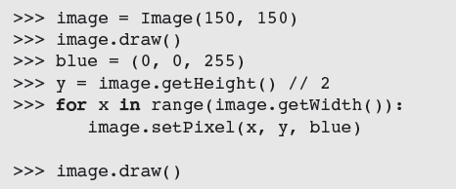
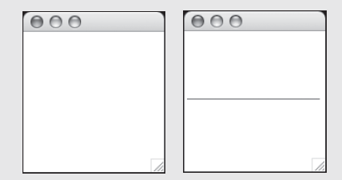

The images Module

Slide 33
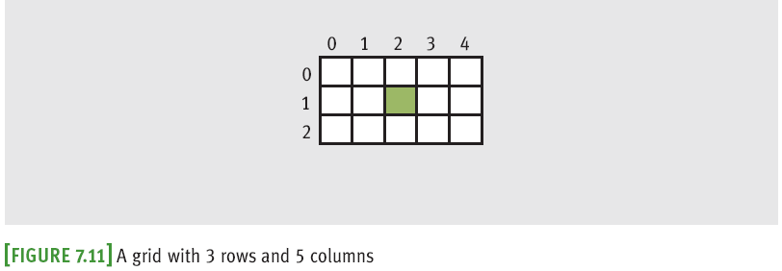
A Loop Pattern for Traversing a Grid
Most of the loops we have used in this book have had a linear loop structure
Many image-processing algorithms use a nested loop structure to traverse a two-dimensional grid of pixels

Slide 34
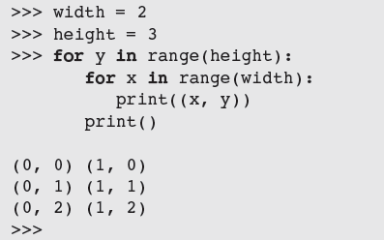

A Loop Pattern for Traversing a Grid
Previous loop uses a row-major traversal
We use this template to develop many of the algorithms that follow:

Slide 35
A Word on Tuples
A pixel’s RGB values are stored in a tuple:

Slide 36
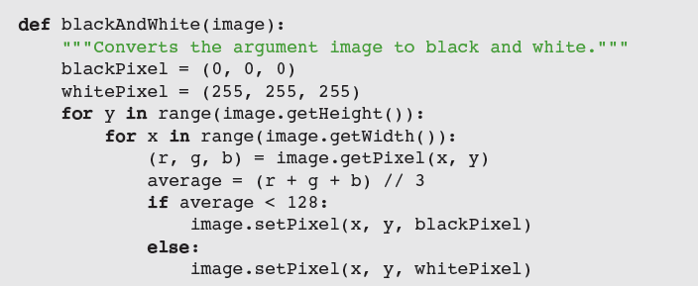
Converting an Image to Black and White
For each pixel, compute average of R/G/B values
Then, reset pixel’s color values to 0 (black) if the average is closer to 0, or to 255 (white) if the average is closer to 255

Slide 37
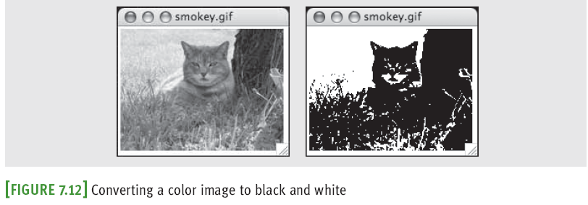
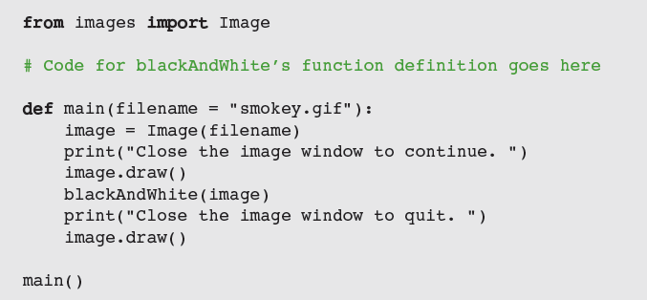
Converting an Image to Black and White

Slide 38

Converting an Image to Grayscale
Black and white photographs contain various shades of gray known as grayscale
Grayscale can be an economical scheme (the only color values might be 8, 16, or 256 shades of gray)
A simple method:
Problem: Does not reflect manner in which different color components affect human perception
Scheme needs to take differences in luminance into account

Slide 39
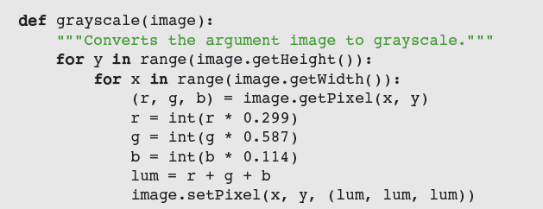
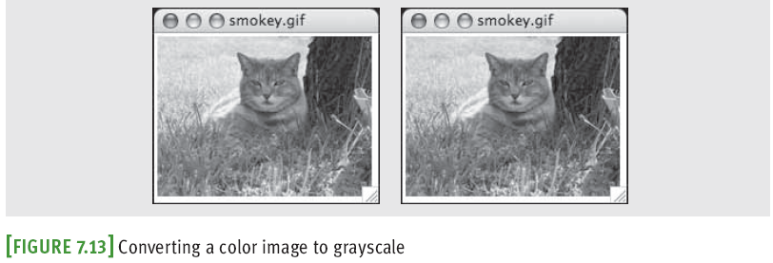
Converting an Image to Grayscale

Slide 40
Copying an Image
The method clone builds and returns a new image with the same attributes as the original one, but with an empty string as the filename

Slide 41
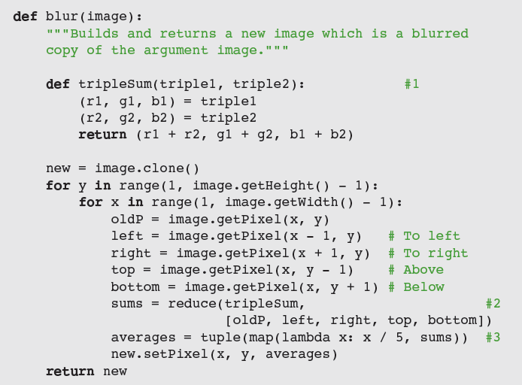
Blurring an Image
Pixilation can be mitigated by blurring

Slide 42
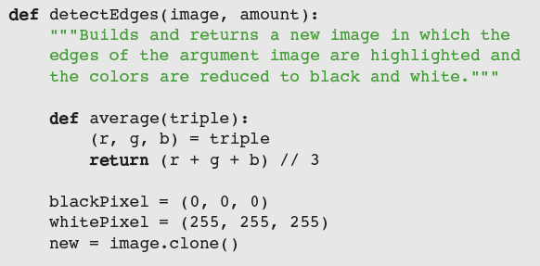

Edge Detection
Edge detection removes the full colors to uncover the outlines of the objects represented in the image

Slide 43
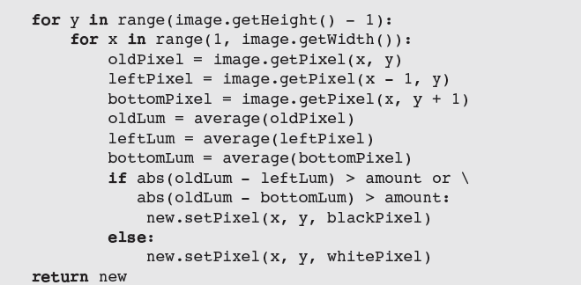
Edge Detection

Slide 44
Reducing the Image Size
The size and the quality of an image on a display medium depend on two factors:
Image’s width and height in pixels
Display medium’s resolution
Measured in pixels, or dots per inch (DPI)
The resolution of an image can be set before the image is captured
A higher DPI causes sampling device to take more samples (pixels) through the two-dimensional grid
A size reduction usually preserves an image’s aspect ratio

Slide 45
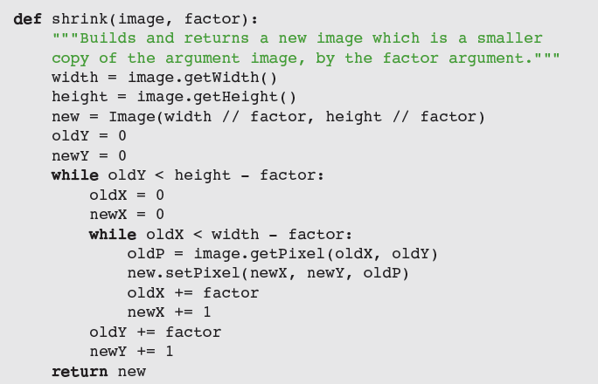
Reducing the Image Size
Reducing size throws away some pixel information

Slide 46
Summary
Object-based programming uses classes, objects, and methods to solve problems
A class specifies a set of attributes and methods for the objects of that class
The values of the attributes of a given object make up its state
A new object is obtained by instantiating its class
The behavior of an object depends on its current state and on the methods that manipulate this state
The set of a class’s methods is called its interface
Turtle graphics is a lightweight toolkit used to draw pictures in a Cartesian coordinate system
RGB system represents a color value by mixing integer components that represent red, green, and blue intensities
A grayscale system uses 8, 16, or 256 distinct shades of gray

Slide 47
Summary
Digital images are captured by sampling analog information from a light source, using a device such as a digital camera or a flatbed scanner
Can be stored in several formats, like JPEG and GIF
When displaying an image file, each color value is mapped onto a pixel in a two-dimensional grid
A nested loop structure is used to visit each position
Image-manipulation algorithms either transform pixels at given positions or create a new image using the pixel information of a source image

